Slide 1

INTRODUCTION TO OUTREACH PROGRAMS OF INFORMATION AGENCIES

Slide 2



At the end of this lesson students will learn:
Definition of Outreach Programs
Background of Outreach Programs of Information Agencies

Slide 3
1.1 Definition of Outreach
“Outreach refers to deliberate efforts made by library institutions to connect with specific target populations or communities beyond the traditional user base or physical confines of the library.
These efforts aim to extend library services, resources, and support to underserved or marginalized groups, to promote literacy, lifelong learning and information access, to strengthen partnerships with community organizations and stakeholders."
Source:
Glossary of Library and Information Science, The American Library Association (ALA)

Slide 4
1.2 Definition of Outreach Programs
“Outreach programs in education are structured initiatives or activities implemented by educational institutions or organizations to engage with and provide educational resources, support services, and opportunities to target populations outside the traditional boundaries of the institution.
These programs aim to increase access to education, address barriers to learning, promote academic success, and foster partnerships with communities."
Source:
Dr. Maria Teresa Tatto
Scholar in educational outreach and community engagement, Arizona State University

Slide 5
1.2.1 Definition of Outreach Programs (Context of Library)
“Outreach programs in libraries are systematic efforts undertaken by library institutions to connect with and serve diverse communities beyond their conventional user base.
Outreach initiatives involve proactive engagement with:
community organizations,
schools, and
local institutions
Outreach programs aims to address:
information needs,
promote literacy,
facilitate lifelong learning, and
foster community empowerment through library resources and expertise."
Source:
The American Library Association (ALA)

Slide 6


1.2.2 Comparison: Outreach Programs and Community Service
Outreach Program
Community Service
By an organization or institution to reach out to a specific target audience or community. | Involves voluntary activities undertaken by individuals or groups to benefit the community or its members.
Engage and connect with individuals or groups who may benefit from the services, resources, or information provided by the organization. | Direct participation in projects or initiatives that contribute to the welfare, improvement, or betterment of the community.
Ex:
Environmental Literacy at Pantai Cenang
Ex:
“Beach clean up” at Pantai Cenang

Slide 7

1.2.2 Comparison: Outreach Programs and Community Service
Outreach Program
Community Service
Involve activities such as educational workshops, forum, informational sessions, community events, or awareness campaigns. | Can take various forms, including volunteering at local organizations, participating in clean-up efforts, tutoring students, or assisting the elderly.
The focus of outreach programs is on communication, engagement, and building relationships with the community to address specific needs or issues. | The focus of community service is on giving back to the community, fostering social responsibility, and making a positive impact on society.
Ex:
Forum on Break all Language Barriers
Ex:
Pemberian amal dan padanan derma

Slide 8

1.2.3 The outreach program at SULAM
01
Introduction to SULAM
SULAM stands for Service Learning Malaysia-University for Society, which is a learning method that provides opportunities for students to contribute their knowledge, skills, and field competencies in addressing community issues or problems. It supports the Higher Education Leap to produce holistic graduates, balanced with entrepreneurial minds. SULAM is also one of the elements that characterize a curriculum having High Impact Educational Practices, which was introduced by the Ministry of Higher Education in 2016.
(SULAM Playbook: Service Learning Malaysia–University for Society, JPT, 2019, p.2).

Slide 9
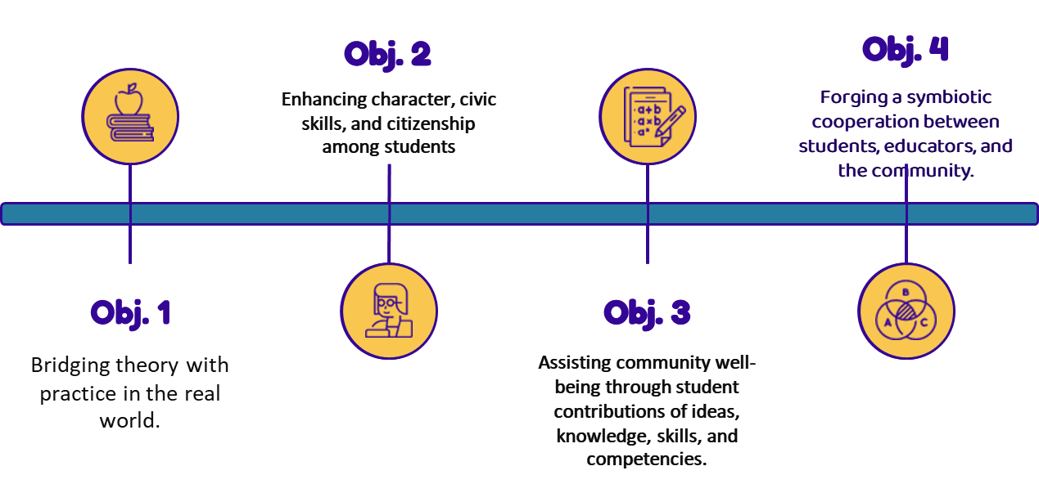
1.2.3 The outreach program at SULAM
02
SULAM Objectives

Slide 10


1.2.3 The outreach program at SULAM
03
Through the objectives of this service learning program, it is hoped to:
Enhance students' knowledge, skills, and competencies in their respective disciplines or fields.
To aid in the development of 21st-century soft skills. Industry engagement is highly encouraged.
Expectations from SULAM Objectives

Slide 11

2.0 Background of Outreach Programs of Information Agencies
Outreach programs of information agencies encompass strategic initiatives aimed at extending the reach of agency services, resources, and information to diverse communities and stakeholders.
These programs are designed to proactively engage with:
target audiences,
raise awareness about available services,
promote information literacy, and
facilitate access to valuable resources.
Source:
The International Federation of Library Associations and Institutions (IFLA)

Slide 12
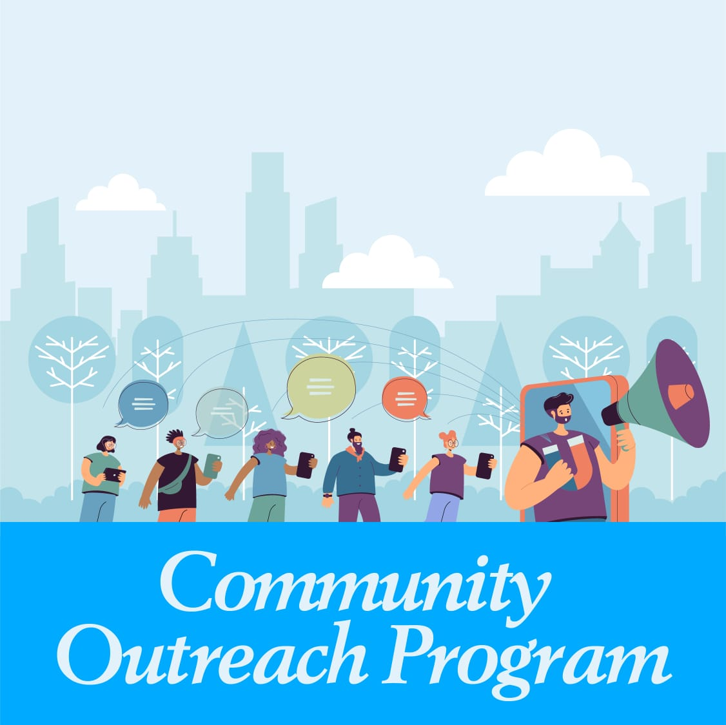
2.1 Purpose of Outreach Programs
The purpose of outreach programs of information agencies is to extend the reach of agency services, resources, and information to diverse communities and stakeholders. These programs aim to:
Increase awareness about the services and resources offered by information agencies.
Promote information literacy and digital literacy skills among target audiences.
Facilitate access to reliable and relevant information for underserved or marginalized populations.
Build partnerships and collaborations with community organizations, schools, and other stakeholders to address information needs effectively.
Foster community engagement and participation in agency activities and initiatives.
Source:
The American Library Association (ALA)
Notes:
Figure 1.1

Slide 13

2.2 Benefits of Outreach Programs
The benefits of outreach programs are:
Enhanced Access: These programs improve access to information and library services for underserved populations, including those who face barriers to visiting the library in person.
Community Engagement: Outreach activities encourage community members to actively participate in library programs, events, and initiatives, fostering a sense of belonging and ownership within the community.
Tailored Services: Through outreach efforts, information agencies can better understand the needs and preferences of diverse community groups, allowing them to tailor their services to meet the specific needs of different populations.
Notes:
Figure 1.1

Slide 14
2.2 Benefits of Outreach Programs
The benefits of outreach programs are:
4. Collaboration and Partnerships: Outreach programs provide opportunities for information agencies to collaborate with other community organizations, schools, and local businesses, enabling them to leverage resources and expand their reach.
5. Empowerment: By providing access to information and educational resources, outreach programs empower individuals to make informed decisions, pursue lifelong learning, and participate more fully in society.
Source:
The American Library Association (ALA)
Notes:
Figure 1.1

Slide 15
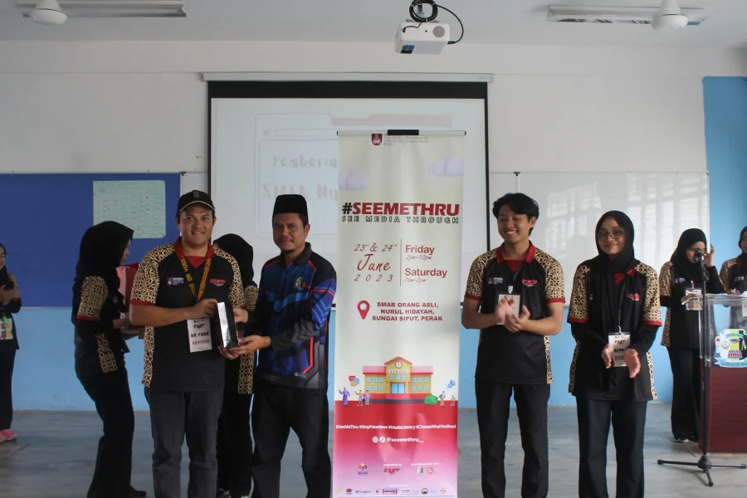
2.3 Forms of Outreach Programs
There are two (2) forms of outreach programs:
Traditional:
Face-to-Face Interaction: Include events, workshops, seminars, orientations.
Tangible Materials: physical materials such as brochures, flyers, posters, and banners to convey information and messages to the audience.
Local Presence: Reaching out to specific local communities or geographic areas.
Credit: Image courtesy of SULAM “Rise of New Media at the Orang Asli Community in Shah Alam”, UiTM Shah Alam via NST
Source:
Meyers-Martin, C., & Lampert, L. D. (2013). Mind the gap: academic library outreach and EOP. Reference Services Review, 41(2). DOI 10.1108/00907321311326156
Notes:
Figure 1.1

Slide 16


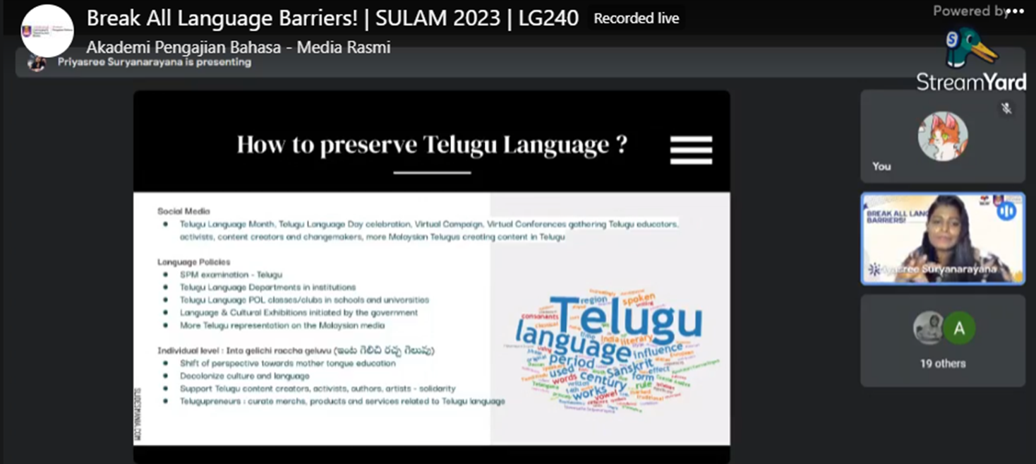
2.3 Forms of Outreach Programs
Online format:
Digital Platforms: such as websites, social media, email newsletters, webinars, podcasts.
Global Reach: Online programs can reach a broader and more diverse audience.
Interactivity: real-time engagement and feedback.
Cost-Effective: cost-effective in terms of production and distribution of materials and reaching a larger audience with fewer resources.
Credit: Image courtesy of e-SULAM Break All Language Barriers!, APB UiTM via FB

Slide 17
2.3 Forms of Outreach Programs
Online format (eSULAM):
SULAM activities can be conducted face-to-face or online.
eSULAM can take place entirely online or partially depending on the suitability of the community project.
The definition of community needs to be clarified, and projects intended for eSULAM implementation should also align with the desires or requirements of the community.
Online format (eSULAM):
To ensure the effectiveness of eSULAM implementation, effective communication through electronic media is essential and documented.
Examples of community activities: website development for promotion, online businesses, YouTube content, or video production based on community needs.

Slide 18
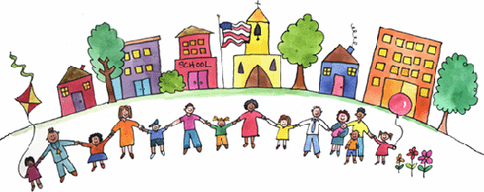
2.4 Categories of Outreach Program Users
Here are some five (5) common categories of users for outreach programs
Community Groups
Students and Educators
Children and Families
Teens and Young Adults
Special Populations
Notes:
Figure 1.2

Slide 19
2.4 Categories of Outreach Program Users
i. Community Groups:
to address their specific information needs and interests. These groups may include organizations, nonprofits.
“ Kumpulan orang yang tinggal di sesuatu daerah atau negara, Masyarakat (di sesuatu tempat atau negara), orang ramai umumnya”.
(Dewan Bahasa dan Pustaka Edisi Keempat, 2015)
“… konsep komuniti adalah merujuk kepada kelompok-kelompok kecil masyarakat yang berada dalam satu-satu kawasan tertentu…perkataan ‘Komuniti’ adalah berasal dari bahasa Perancis kuno dipanggil ‘communité’ yang asalnya dari bahasa Latin dipanggil ‘communitas’…” (Abdullah, M. S. et al., 2017)
Notes:
Figure 1.2

Slide 20
2.4 Categories of Outreach Program Users
ii. Students and Educators:
collaborate with schools and educational institutions.
iii. Children and Families:
to promote literacy, lifelong learning.
iv. Teens and Young Adults:
tailored to the interests and needs of teenagers and young adults.
Notes:
Figure 1.2

Slide 21
2.4 Categories of Outreach Program Users
v. Special Populations:
people with disabilities,
incarcerated individuals / people in Detention Institution.
Example of people in Detention Institution:
Prison
Juvenile Detention Center
Immigration Detention Center
Psychiatric Prison
Notes:
Figure 1.2

Slide 22
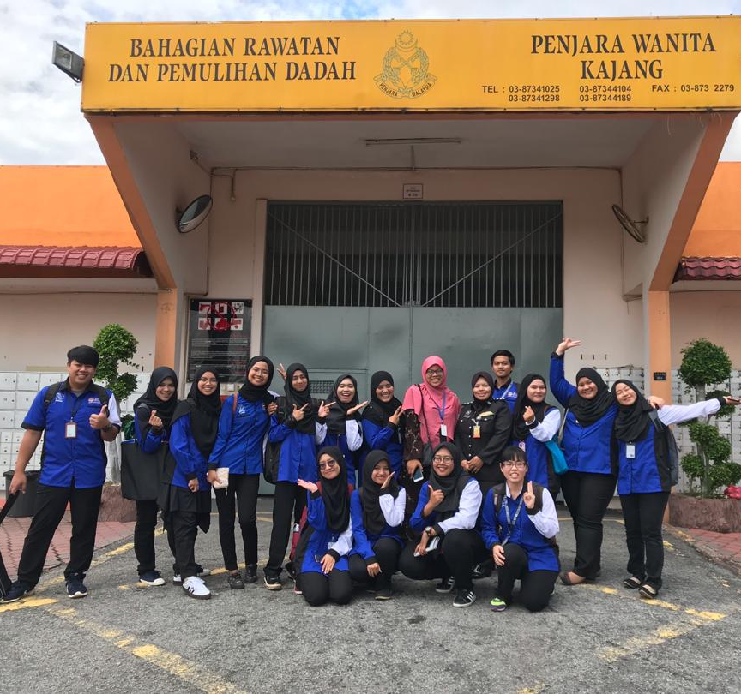
2.4 Categories of Outreach Program Users
v. Special Populations:
Example of people in Detention Institution:
Prison
A place where those convicted of violating a federal law under the legal system, who are then incarcerated at a prison that exclusively, houses similar criminals.
Credit: Image courtesy of Jabatan Psikologi dan Kaunseling, UPSI via FB
Notes:
Figure 1.2

Slide 23

2.4 Categories of Outreach Program Users
v. Special Populations:
Example of people in Detention Institution:
Juvenile Detention Center
Juvenile offenders in most countries are adjudicated and confined in a justice system separate from that which deals with adults. A secure residential facility for young people, often termed juvenile delinquents, awaiting court hearings and/or placement in long-term care facilities and programs.
REMAJA DAN RAMADAN, HENRY GURNEY MELAKA
Credit: Image courtesy of JAKIM, via JAKIM Website
Notes:
Figure 1.2

Slide 24
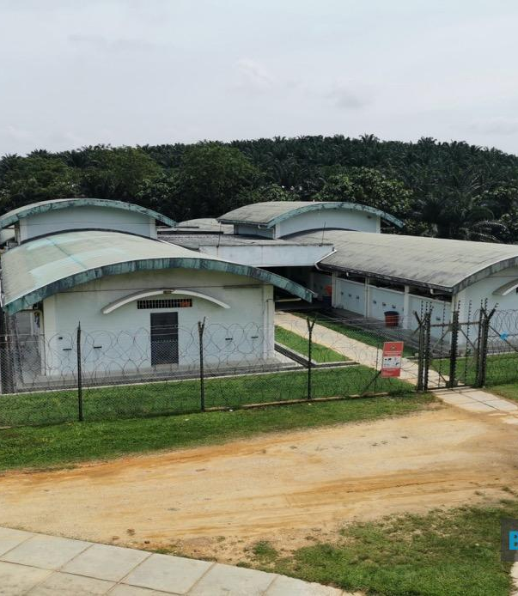
2.4 Categories of Outreach Program Users
v. Special Populations:
Example of people in Detention Institution:
Immigration Detention Center
Individuals held in an immigration detention center face no other criminal charge beyond unlawful entry into a country or a similar alleged crime. In some instances, a person held in an immigration facility has served a sentence for another type of crime in a country detention center and is transferred to an immigration facility after that sentence, awaiting transfer out of the country.
Credit: Image courtesy of KLIA, Sepang Immigration Detention Center
, via Bernama
Notes:
Figure 1.2

Slide 25
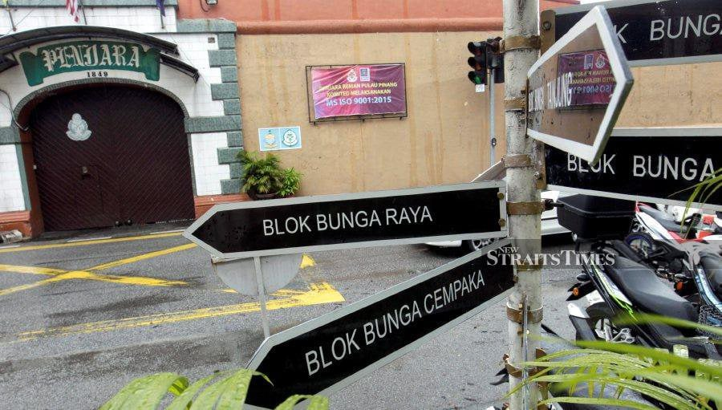
2.4 Categories of Outreach Program Users
v. Special Populations:
Example of people in Detention Institution:
4. Psychiatric Prison
Some psychiatric facilities have characteristics of prisons, particularly when confining patients who have committed a crime and are considered dangerous. In addition, many prisons have psychiatric units dedicated to housing offenders diagnosed with a wide variety of mental disorders.
Credit: Image courtesy of Kajang Prison, via NSTP
Notes:
Figure 1.2

Slide 26




2.5 Outreach Program Framework
COMMUNITY
01
02
INDUSTRY
Issues/ Problems/ Needs
03
IMPACTS
COMMUNITY INTEREST
REFLECTION
04
05
Garis Panduan Pelaksanaan
SULAM@UiTM
Service-Learning Malaysia – University for Society

Slide 27
2.6 PROJECT CRITERIAS
(BASED ON SULAM@UiTM)
01
Meeting the needs of the community
02
Collaboration among students, educators, universities, and the community
05
Involvement and support of industries / statutory bodies are highly encouraged.
03
04
Long-term concept
Impactful and measurable
(SULAM Playbook: Service-Learning Malaysia – University for Society, JPT, 2019)

Slide 28


The Importance of Outreach Programs, Particularly in Information Agencies
In conclusion, outreach programs play a vital role, particularly within information agencies, by serving as bridges between institutions and the communities they serve. These programs facilitate the dissemination of accurate information, promote community engagement, and foster trust and collaboration. By actively reaching out to diverse populations and addressing their informational needs, information agencies can strengthen their relevance and impact.

Slide 29

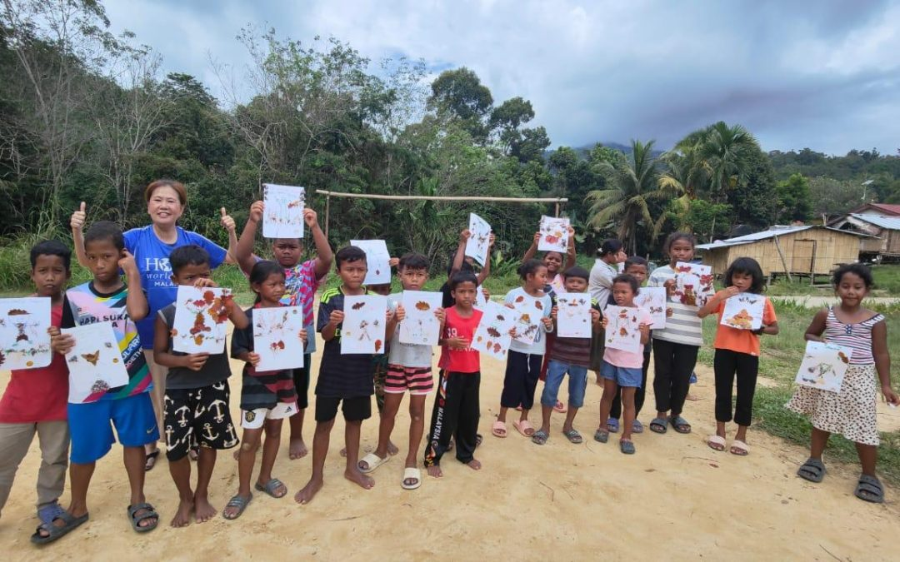
Exercise 1
Q: Indicate whether the given picture corresponds to an Outreach Program OR Community Service?

Slide 30
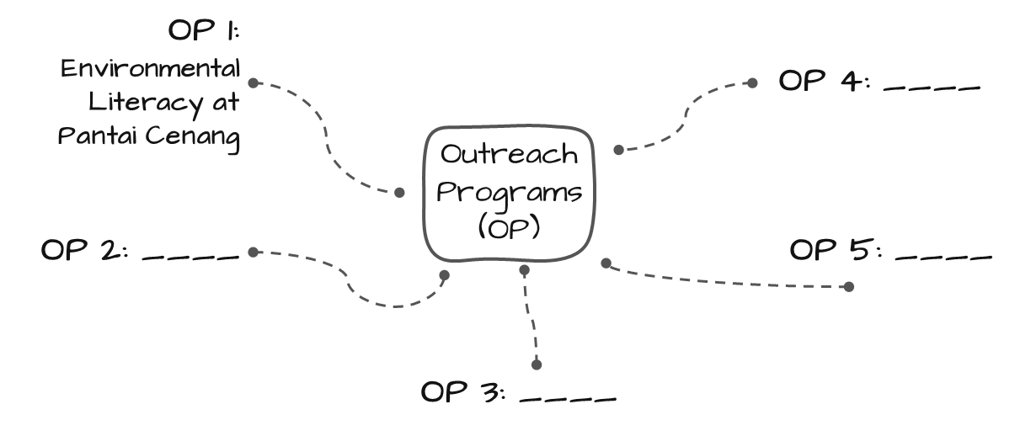
Exercise 2
Now that you understand the difference, kindly provide FOUR (4) examples of outreach programs (OP) implemented by information agencies.
Within 10 minutes, participate in a discussion with your group of four.

Slide 31
Awesome Words
Outreach programs…… are not just about extending a helping hand; they're about empowering individuals, amplifying voices, and co-creating a brighter, more inclusive future.
Professor John Smith
Thank You

